Slide 1
Classes and Object
Instructor: DieuNT1

Slide 2
Table of contents
OOPs Concepts
Heap Space vs Stack Memory
Method Parameters

Slide 3
Learning Approach
Strongly suggested for a better learning and understanding of this course:
Noting down the key concepts in the class
Analyze all the examples / code snippets provided
Study and understand the self study topics
Completion and submission of all the assignments, on time
Completion of the self review questions in the lab guide
Study and understand all the artifacts
Completion of the project on time inclusive of individual and group activities
Notes:
The following are strongly suggested for a better learning and understanding of this course:
Noting down the key concepts in the class
Analyze all the examples / code snippets provided
Study and understand the self study topics
Completion and submission of all the assignments, on time
Completion of the self review questions in the lab guide
Study and understand all the artifacts including the reference materials / e-learning / supplementary materials specified
Completion of the project (if application for this course) on time inclusive of individual and group activities
Taking part in the self assessment activities
Participation in the doubt clearing Sections

Slide 4
OOPs Concepts
Section 1

Slide 5
What is a Class?
A class can be considered as a blueprint using which you can create as many objects.
For example, create a class House that has three instance variables:
This is just a blueprint, it does not represent any House
We have created two objects, while creating objects we provided separate properties to the objects using constructor.
public class House {
String address;
String color;
double are;
void openDoor() {
// TODO
}
void closeDoor() {
// TODO
}
}
public class HouseManagement {
public static void main(String[] args) {
House house1 = new House("Duytan", "Blue", 1000);
House house2 = new House("Tonthatthuyet", "Green", 1200);
System.out.println(house1.address + "\t" + house1.color +
"\t" + house1.are);
System.out.println(house2.address + "\t" + house2.color +
"\t" + house2.are);
}
}

Slide 6
What is an Object
Object: is a bundle of data and its behaviour (often known as methods).
Objects have two characteristics: They have states and behaviors.
Example of states and behaviors
Object: House
State: Address, Color, Area
Behavior: Open door, close door

Slide 7
Class syntax
Create new object type with class keyword.
A class definition can contain:
instance variables (attribute/fields)
constructors
methods (instance method, static method)
Syntax:
[public][<abstract><final>]class <ClassName>
[extends <SuperClass>] [implements <InterfaceName>]{
<Attribute/Field declarations { initialization code }>
<Constructors>
<Methods>
}

Slide 8
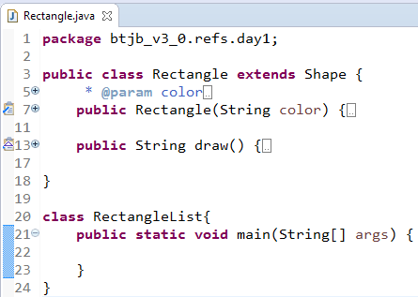
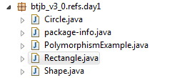
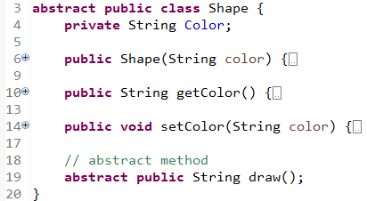
Java Class: Modifiers
public: that class is visible to all classes everywhere.
only one public class per file, must have same name as the file (this is how Java finds it!).
If a class has no modifier (the default, also known as package-private)
It is visible only within its own package.
Abstract modifier means that the class can be used as a superclass only.

Slide 9
Creating an Object
Defining a class does not create an object of that class - this needs to happen explicitly^{[tường minh]}:
House myHouse = new House("Duytan","Blue", 1000);
In general, an object must be created before any methods can be called.
the exceptions are static methods.
Name of an Object
Automatically Calls the Constructor
Class name
Automatically Create Object using new

Slide 10
FooPrinter.java
class FooPrinter {
static final String UPPER = "FOO";
static final String LOWER = "foo";
// instance variable, do we print upper or lower?
boolean printUpper = false;
void upper() {
printUpper = true;
}
void lower() {
printUpper = false;
}
void print() {
if (printUpper)
System.out.println(UPPER);
else
System.out.println(LOWER);
}
}

Slide 11
What does it mean to create an object?
public class SimpleClass {
public static void main(String[] args) {
FooPrinter foo = new FooPrinter();
foo.print();
foo.upper();
foo.print();
}
}
Output:
foo
FOO
An object is a chunk of memory:
holds field values
holds an associated object type
All objects of the same type share code
they all have same object type, but can have different field values.

Slide 12
Constructors
Constructor is a block of code that initializes the newly created object.
Constructor has same name as the class
People often refer constructor as special type of method in Java. It doesn’t have a return type
You can create multiple constructors, each must accept different parameters.
If you don't write any constructor, the compiler will (in effect) write one for you:
FooPrinter(){}
If you include any constructors in a class, the compiler will not create a default constructor!

Slide 13
How does a constructor work
When new keyword here creates the object of class Car and invokes the constructor to initialize this newly created object.
public class Car {
String color;
String brand;
double weight;
String model;
public Car() {
}
public Car(String color, String brand) {
this.color = color;
this.brand = brand;
}
public Car(String color, String brand,
double weight, String model) {
this.color = color;
this.brand = brand;
this.weight = weight;
this.model = model;
}
}
@Override
public String toString() {
return "Car [color=" + color + ", brand=" +
brand + ", weight=" + weight + ", model=" +
model + "]";
}
public class CarManagement {
public static void main(String[] args) {
Car ford = new Car("White", "Ford",
1000, "2017");
Car audi = new Car("Black", "Audi");
}
}

Slide 14
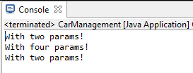
Multiple (overload) Constructors
Must accept different parameters.
One constructor can call another, use this, not the classname:
What will print out?
public class Car {
String color;
String brand;
double weight;
String model;
public Car() {
System.out.println("No params!");
}
public Car(String color, String brand) {
this.color = color;
this.brand = brand;
System.out.println("With two params!");
}
public Car(String color, String brand, double weight,
String model) {
this(color, brand);
this.weight = weight;
this.model = model;
System.out.println("With four params!");
}
}
public class CarManagement {
public static void main(String[] args) {
Car ford = new Car("White", "Ford",
1000, "2017");
Car audi = new Car("Black", "Audi");
}
}
Notes:
A call to this() must be the first statement in the constructor!

Slide 15
Destructors
Nope!
There is a finalize() method that is called when an object is destroyed:
You don't have control over when the object is destroyed (it might never be destroyed).
The JVM garbage collector takes care of destroying objects automatically (you have limited control over this process).

Slide 16
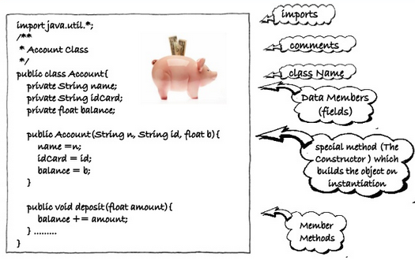
Instance variable (Field)
Instance variable in java is used by objects to store their states
Fields (data members) can be any primitive or reference type
Syntax:
[Access modifier] <Data type> <field_name>;

Slide 17
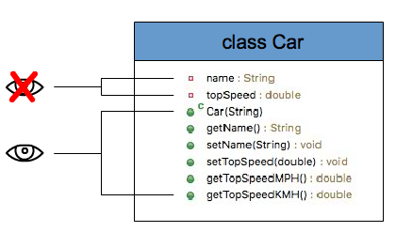
Instance variable (Field)
The following table shows the access to members permitted by each modifier:
Example:
Modifier | Class | Package | Subclass | World
public | Y | Y | Y | Y
protected | Y | Y | Y | N
no modifier | Y | Y | N | N
private | Y | N | N | N

Slide 18
Instance method
Instance method are methods which require an object of its class to be created before it can be called.
Access modifiers: same idea as with fields.
private/protected/public/no modifier:
No access modifier:
abstract: no implementation given, must be supplied by subclass.
final: the method cannot be changed by a subclass (no alternative implementation can be provided by a subclass).

Slide 19
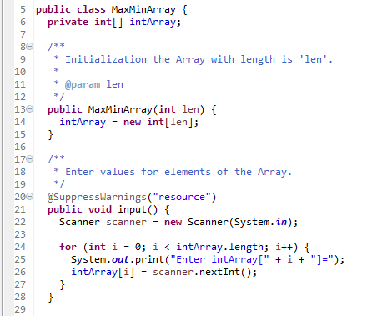
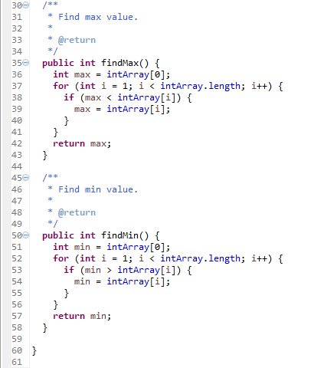
Instance method
Notes:
import java.util.Scanner;
public class MaxMinArray {
private int[] intArray;
/**
* Initialization the Array with length is 'len'.
*
* @param len
*/
public MaxMinArray(int len) {
intArray = new int[len];
}
/**
* Enter values for elements of the Array.
*/
@SuppressWarnings("resource")
public void input() {
Scanner scanner = new Scanner(System.in);
for (int i = 0; i < intArray.length; i++) {
System.out.print("Enter intArray[" + i + "]=");
intArray[i] = scanner.nextInt();
}
}
/**
* Find max value.
*
* @return
*/
public int findMax() {
int max = intArray[0];
for (int i = 1; i < intArray.length; i++) {
if (max < intArray[i]) {
max = intArray[i];
}
}
return max;
}
/**
* Find min value.
*
* @return
*/
public int findMin() {
int min = intArray[0];
for (int i = 1; i < intArray.length; i++) {
if (min > intArray[i]) {
min = intArray[i];
}
}
return min;
}
}
public class MaxMinTest {
public static void main(String[] args) {
MaxMinArray maxMinArray = new MaxMinArray(5);
maxMinArray.input(); // call input() method
System.out.println("Max value: "+ maxMinArray.findMax()); // call findMax() method and return max value
System.out.println("Min value: "+ maxMinArray.findMin()); // call findMin() method and return min value
}
}

Slide 20
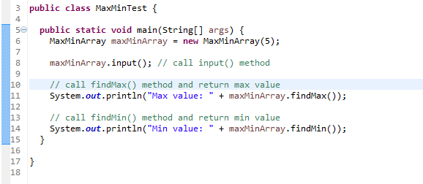
Instance method
Output:
Enter intArray[0]=4
Enter intArray[1]=2
Enter intArray[2]=-2
Enter intArray[3]=8
Enter intArray[4]=3
Max value: 8
Min value: -2

Slide 21
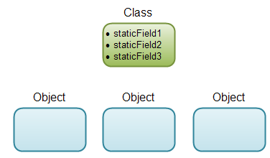
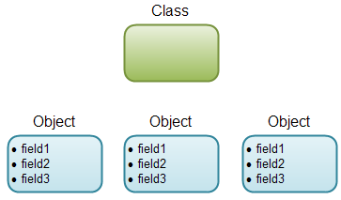
Static fields
Fields declared static are called class fields (class variables).
others are called instance fields.
There is only one copy of a static field, no matter how many objects are created.
Non-Static field
Static field
Notes:
Or: ObjCount.java

Slide 22
Static fields Examples
class Student {
int rollno;
String name;
static String college;
static {
college = "ITS";
System.out.println("Static block");
}
Student(int rollno, String name) {
this.rollno = rollno;
this.name = name;
System.out.println("Constructor block");
}
void display() {
System.out.println(rollno + " " + name + " " + college);
}
static void changeCollege() {
college = "FU";
}
}
public static void main(String args[]) {
// Student.changeCollege();
Student s1 = new Student(111, "Karan");
Student s2 = new Student(222, "Aryan");
Student.changeCollege();
s1.display();
s2.display();
}
111 Karan FU
222 Aryan FU

Slide 23
Static methods
Static methods are the methods in Java that can be called without creating an object of class.
Instance method can access the instance methods and instance variables directly.
Instance method can access static variables and static methods directly.
Static methods can access the static variables and static methods directly.
Static methods can’t access instance methods and instance variables directly.
Syntax:
static return_type method_name();

Slide 24
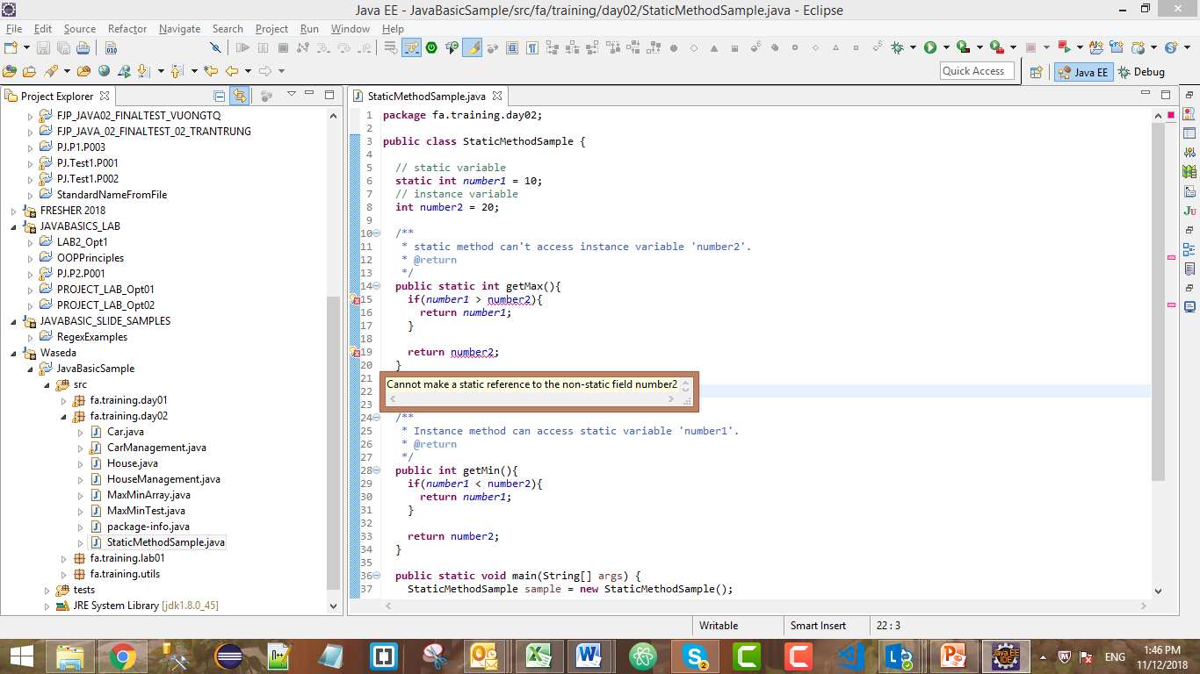
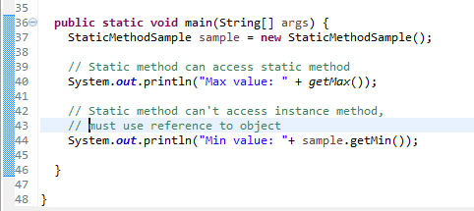
Static methods

Slide 25
Final Fields
The keyword final means: once the value is set, it can never be changed.
They must be static if they belong to the class.
Not be static if they belong to the instance of the class.
Typically used for constants:
Important Note:
A final variable that is not initialized at the time of declaration is known as blank final variable.
We can initialize blank final variable in constructor.
A static final variable that is not initialized at the time of declaration is known as static blank final variable.
It can be initialized only in static block.

Slide 26
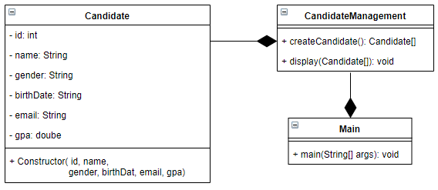

Practical time
Implement the class diagram below by java:

Slide 27
HEAP SPACE VS STACK MEMORY
Section 2

Slide 28
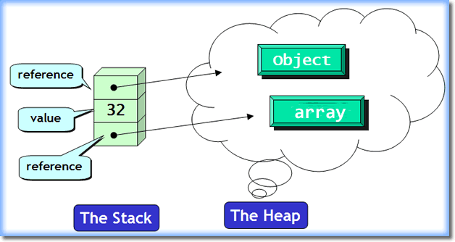
Introduction
To run an application in an optimal way, JVM divides memory into stack and heap memory.
Declare new variables and objects, call new method, declare a String or perform similar operations
➔ JVM designates memory to these operations from either Stack Memory or Heap Space.

Slide 29
Stack Memory
Stack Memory in Java is used for static memory allocation and the execution of a thread.
It contains primitive values that are specific to a method and references to objects that are in a heap, referred from the method.
Access to this memory is in Last-In-First-Out (LIFO) order.
It grows and shrinks as new methods are called and returned respectively
Variables inside stack exist only as long as the method that created them is running
It’s automatically allocated and deallocated when method finishes execution
If this memory is full, Java throws java.lang.StackOverFlowError
Access to this memory is fast when compared to heap memory
This memory is threadsafe as each thread operates in its own stack

Slide 30
Heap Space
Heap space in Java is used for dynamic memory allocation for Java objects and JRE classes at the runtime.
New objects are always created in heap space and the references to this objects are stored in stack memory.
If heap space is full, Java throws java.lang.OutOfMemoryError
Access to this memory is relatively slower than stack memory
This memory, in contrast to stack, isn’t automatically deallocated. It needs Garbage Collector to free up unused objects so as to keep the efficiency of the memory usage
Unlike stack, a heap isn’t threadsafe and needs to be guarded by properly synchronizing the code

Slide 31
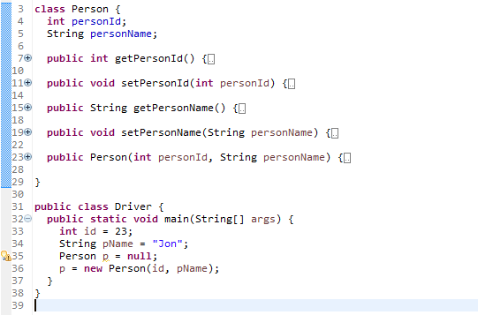
Heap Space vs Stack Memory
Notes:
class Person {
int personId;
String personName;
public int getPersonId() {
return personId;
}
public void setPersonId(int personId) {
this.personId = personId;
}
public String getPersonName() {
return personName;
}
public void setPersonName(String personName) {
this.personName = personName;
}
public Person(int personId, String personName) {
super();
this.personId = personId;
this.personName = personName;
}
}
public class Driver {
public static void main(String[] args) {
int id = 23;
String pName = "Jon";
Person p = null;
p = new Person(id, pName);
}
}

Slide 32
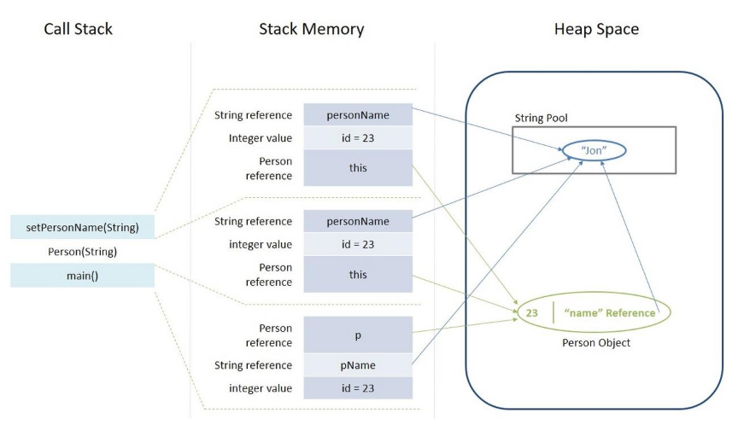
Heap Space vs Stack Memory

Slide 33
PARAMETERS
Section 3

Slide 34
Parameters
Parameters (also called arguments) is variable that declare in the method definition.
Parameters are always classified as "variables" not "fields".
Two ways to pass arguments to methods
Pass-by-value
Pass-by-reference

Slide 35
Value and Reference Parameters
Pass-by-value
Copy of argument’s value is passed to called method
In Java, every primitive^{[nguyên thủy]} is pass-by-value
Pass-by-reference
Caller gives called method direct access to caller’s data
Called method can manipulate this data
Improved performance over pass-by-value
In Java, every object is pass-by-reference
In Java, arrays are objects
Therefore, arrays are passed to methods by reference

Slide 36
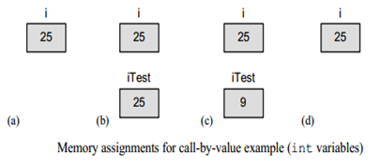
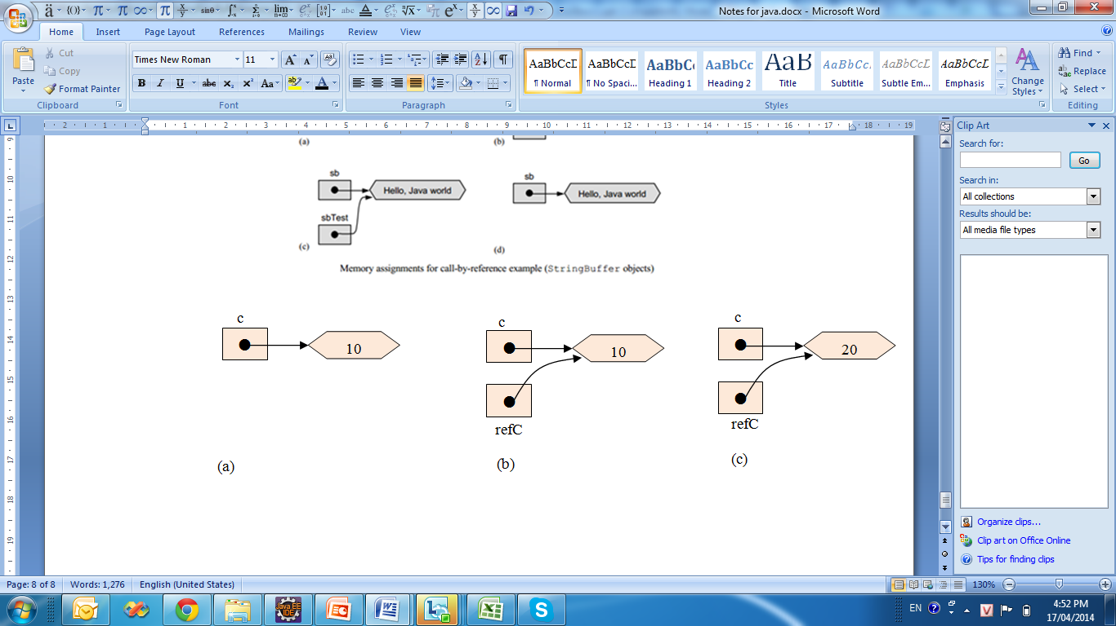
Value and Reference Parameters(2)
Example: reference DemoPassByReference.java
Ananys:

Slide 37
Passing Arrays to Methods
To pass an array argument to a method
Create a method
public void modifyArray(int[] arr)
Array hourlyTemperatures is declared as
int[] hourlyTemperatures = new int[24];
Passes array hourlyTemperatures to method modifyArray
modifyArray(hourlyTemperatures);
Example: reference PassArray.java

Slide 38
Passing Arrays to Methods
public class PassArray {
// initialize applet
public static void main(String args[]) {
int array[] = { 1, 2, 3, 4, 5 };
String output = "Effects of passing entire array by reference:\n"
+ "The values of the original array are:\n";
// append original array elements to String output
for (int counter = 0; counter < array.length; counter++)
output += " " + array[counter];
modifyArray(array); // array passed by reference
output += "\n\nThe values of the modified array are:\n";
// append modified array elements to String output
for (int counter = 0; counter < array.length; counter++)
output += " " + array[counter];
output += "\n\nEffects of passing array element by value:\n"
+ "array[3] before modifyElement: " + array[3];
modifyElement(array[3]); // attempt to modify array[ 3 ]
output += "\narray[3] after modifyElement: " + array[3];
System.out.println(output);
} // end method init

Slide 39
Passing Arrays to Methods
// multiply each element of an array by 2
public static void modifyArray(int array2[]) {
for (int counter = 0; counter < array2.length; counter++)
array2[counter] *= 2;
}
// multiply argument by 2
public static void modifyElement(int element) {
element *= 2;
}
} // end class PassArray
Effects of passing entire array by reference:
The values of the original array are:
1 2 3 4 5
The values of the modified array are:
2 4 6 8 10
Effects of passing array element by value:
array[3] before modifyElement: 8
array[3] after modifyElement: 8

Slide 40
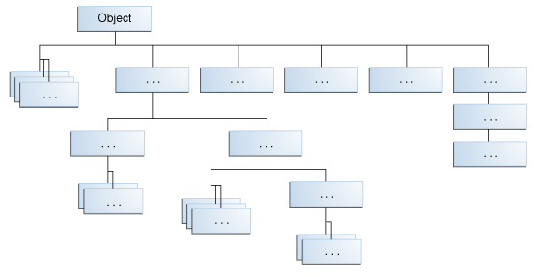
The class Object
Granddaddy of all Java classes.
All methods defined in the class Object are available in every class.
Any object can be cast as an Object.

Slide 41
Summary
OOPs Concepts
Heap Space vs Stack Memory
Method Parameters

Slide 42

Thank you
42

